Slide 1

Analyzing in-store markdowns and their impact on sales in different seasonal and economic conditions in the US
Team leader: Leslie S. Lopez-Espinoza Submitted to: Stephen Perelgut
Members: Benedicto Gerald Blanco Presented on: 12 August 2021
Hazel Elif Ercin
Dheeraj Savanthy
Visnhu Soman

Slide 2
Recommendation Overview
Task:
Analyze effectiveness of Walmart’s markdowns in increasing revenue in different market conditions influenced by external factors
Recommendation: Focus on EDLP, remove additional markdowns
Rationale:
Relationship between sales and markdowns, seasonality and holiday is muted while on EDLP
Impact of seasonality and macroeconomic factors is insignificant, in context of EDLP
Markdowns are already concentrated in selected and strategic regions
Notes:
Recommend additional data to better assess new locations for Captain Burgers’ store expansion
Before making the reco – a few assumptions are made. Without these assumptions, the reco will not be highly targeted.
Mainstream – not catering to specific group of consumers, not ultra expensive
Mainly sit-in over delivery – why is this important, delivery – foot traffic is not important
Apolitical
Recommendation:
Exposure to large consumer groups – traffic is very important
Competition is a critical component in predicting commercial performance
Crime Rate – this affects traffic and consumers’ willingness to eat out

Slide 3
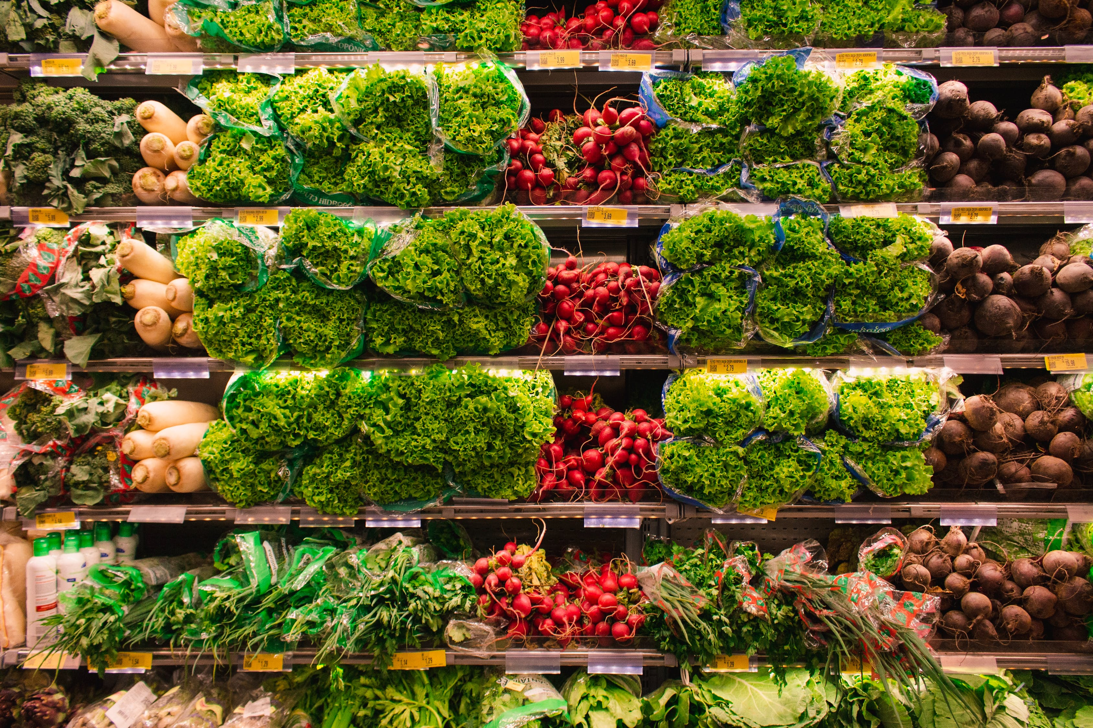
Business Background
Retail Food and Grocery → $1.46B
Biggest retailer → $300M
Every Day Low Price (EDLP)
Scale supporting ELDP
Subject to external factors
Competitors → high-low pricing strategy

Slide 4
Business Background
3 major store types by floor size

Slide 5
High Nov-Dec sales; Holiday purchase over 8 weeks

Slide 6
Research Objective
Analyze effectiveness of markdowns in driving revenue in different market conditions influenced by external factors
Analyze the following:
Price markdowns impact on sales revenue
Impact of seasonality, holiday, macroeconomic factors and markdowns in driving revenue growth
Effective use of markdowns to mitigate risk and maximize growth

Slide 7
Data and Modelling Process
Collection
From Walmart
Challenge: Develop a model
Contents
Internal: Price, Sales, Stores
External: CPI, Fuel, Unemployment
Processing
Review, Clean, Select
Derive Variables
Modelling
Visual Analysis
Correlation and Regression

Slide 8
Muted relationships while on EDLP
Markdown 5
0.050
Unemployment
-0.026
CPI
-0.021
Holiday
0.013
Temperature
-0.002

Slide 9
Insignificant impact on weekly sales while on EDLP
0.060
0.0004
0.0001
0.0009
0.0002
Size
CPI
Size
Markdown 3
Unemployment

Slide 10
Regions A and B have more categories and at higher levels of markdown

Slide 11

Bigger store size not higher efficiency

Slide 12
Limitations
Covid-19 – changes in product, channel, pricing and other market dynamics
Online – rise of Amazon
Walmart Changes – operations mix change in the past 5 years
Competition – no available data
Aggregated data – granular category / department data

Slide 13
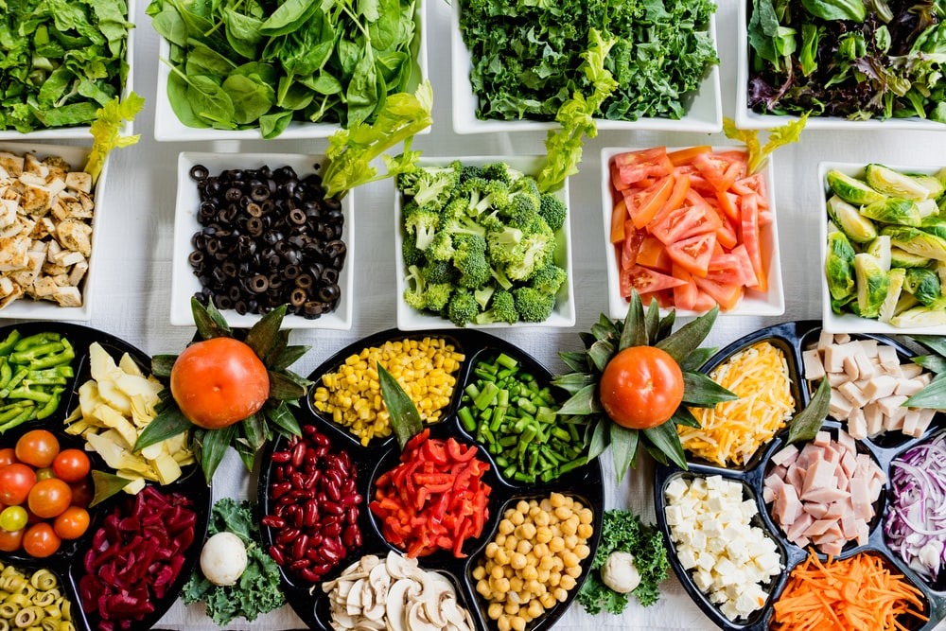

Modelling by category – More Insightful

Slide 14
Summary
Recommendation: Maintain EDLP
No clear relationship between external factors and markdowns with EDLP
No evidence of uplift with any or combination of factors with EDLP
Markdowns concentrated in select and strategic regions

